Slide 1

Drivers of rent: Presentation to the HTWG
Enzo Cassino (RBNZ) and Nam Ngo (HUD)
August 2022

Slide 2
Why are we interested in this?
Rent is more closely related to the (wellbeing) outcomes
renters typically pay a larger proportion of their incomes on housing costs compared to homeowners
Rent price could be a better signal of the supply-demand imbalance in the housing market
it reflects the “true” cost of housing consumption
Research on drivers of rent are quite limited, both internationally and in NZ

Slide 3
Approach
We have identified a list of possible factors that may drive rent from the literature:
Variables | Channel | Expected sign
Lagged rent inflation | Persistence | +
Income/wage | Renters’ ability to pay | +
Relative demand and supply |  | +
Home loan credit conditions | Homeownership rate | -
General inflation | Landlords’ expense | +
Labour market conditions, e.g unemployment rate | Job security Economic outlook | +
Interaction of two or more of the above

Slide 4
Approach
A simple, reduced-form equation with lags in order to reduce endogeneity issue
Main dependent variable: Rent inflation (Quarterly change of RPI)
Estimation period: Q1-2007 to Q1-2022

Slide 5
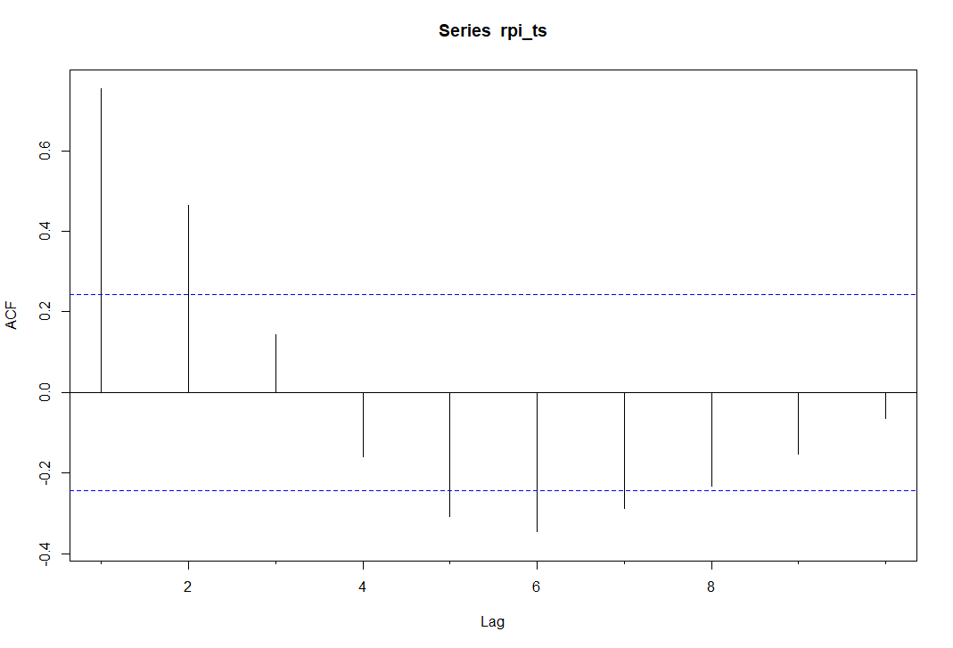
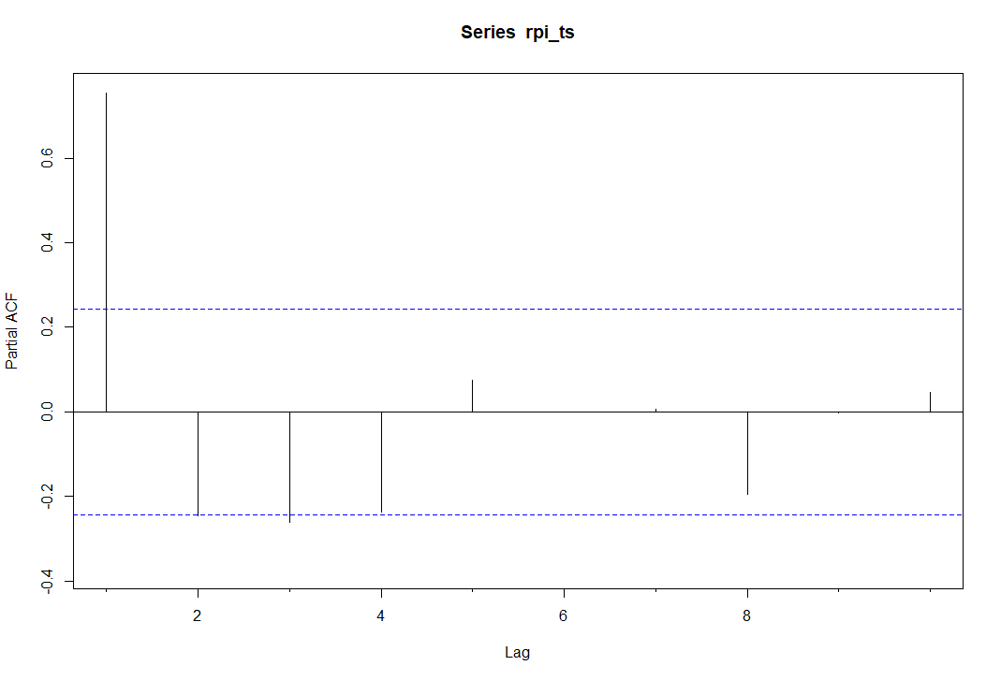
At least the first lag of rent inflation needed to be included as an explanatory variable

Slide 6
Most key variables have expected signs
 | Annual rent inflation | Annual rent inflation | Annual rent inflation | Annual rent inflation | Annual rent inflation
Rent inflation (lagged) | 0.733 *** (0.088) | 0.716 *** (0.089) | 0.531 *** (0.109) | 0.532 *** (0.111) | 0.557 *** (0.123)
Wage growth (deviation from sample mean 3.66, lagged) | 0.165 * (0.088) | 0.188 ** (0.090) | 0.224 ** (0.087) | 0.225 ** (0.099) | 0.250 ** (0.108)
People per dwelling (deviation from sample mean 2.57, lagged) |  | 3.312 (3.171) | 4.498 (3.044) | 4.489 (3.100) | 5.981 (3.843)
Change in floating mortgage rate (lagged) |  |  | 0.033 *** (0.012) | 0.033 ** (0.012) | 0.033 ** (0.013)
Inflation excluding rents |  |  |  | -0.002 (0.090) | 0.016 (0.097)
Unemployment rate (lagged) |  |  |  |  | 0.131 (0.191)
Observations | 64 | 64 | 64 | 64 | 62
R² / R² adjusted Quarter fixed effects | 0.622 / 0.589 Yes | 0.629 / 0.590 Yes | 0.671 / 0.630 Yes | 0.671 / 0.623 Yes | 0.674 / 0.617 Yes
* p<0.1 ** p<0.05 *** p<0.01
Notes:
Interpretation in the next slide

Slide 7
Most key variables have expected signs
 | Quarterly rent inflation | Quarterly rent inflation | Quarterly rent inflation | Quarterly rent inflation | Quarterly rent inflation
Predictors | Estimates | Estimates | Estimates | Estimates | Estimates
Rent inflation (1st lag) | 0.00 (0.13) | -0.06 (0.13) | -0.09 (0.13) | -0.10 (0.13) | -0.10 (0.13)
Rent inflation (2nd lag) | -0.15 (0.13) | -0.19 (0.13) | -0.31 ** (0.13) | -0.32 ** (0.14) | -0.32 ** (0.14)
Wage growth (deviation from sample mean 0.93, lagged) | 0.34 ** (0.15) | 0.32 ** (0.14) | 0.36 ** (0.14) | 0.34 ** (0.14) | 0.34 ** (0.15)
People per dwelling (deviation from sample mean 2.57, lagged) |  | 5.16 * (2.60) | 4.88 * (2.51) | 5.20 ** (2.56) | 5.20 * (2.92)
Change in floating mortgage rate (lagged) |  |  | 0.05 ** (0.02) | 0.04 * (0.02) | 0.04 * (0.02)
General inflation |  |  |  | 0.13 (0.18) | 0.13 (0.20)
Unemployment rate (lagged) |  |  |  |  | -0.00 (0.13)
Observations | 57 | 57 | 57 | 57 | 57
R² / R² adjusted | 0.390 / 0.317 | 0.436 / 0.355 | 0.489 / 0.404 | 0.495 / 0.398 | 0.495 / 0.385
* p<0.1 ** p<0.05 *** p<0.01
Notes:
Interpretation in the next slide

Slide 8
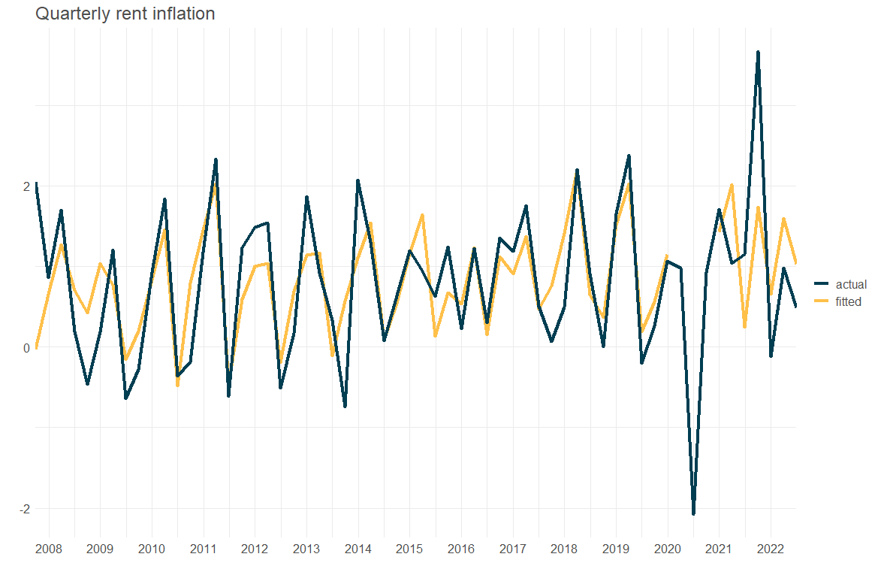

Slide 9
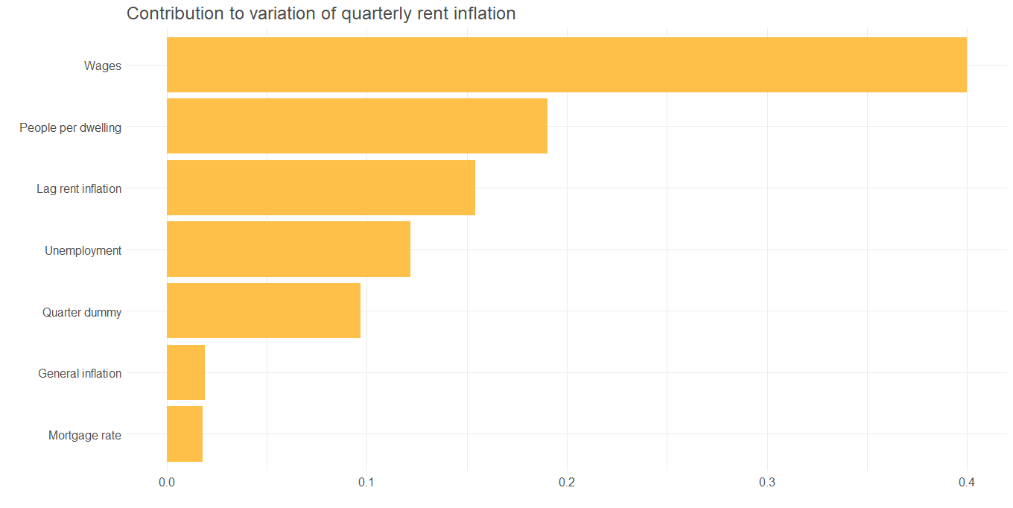

Slide 10
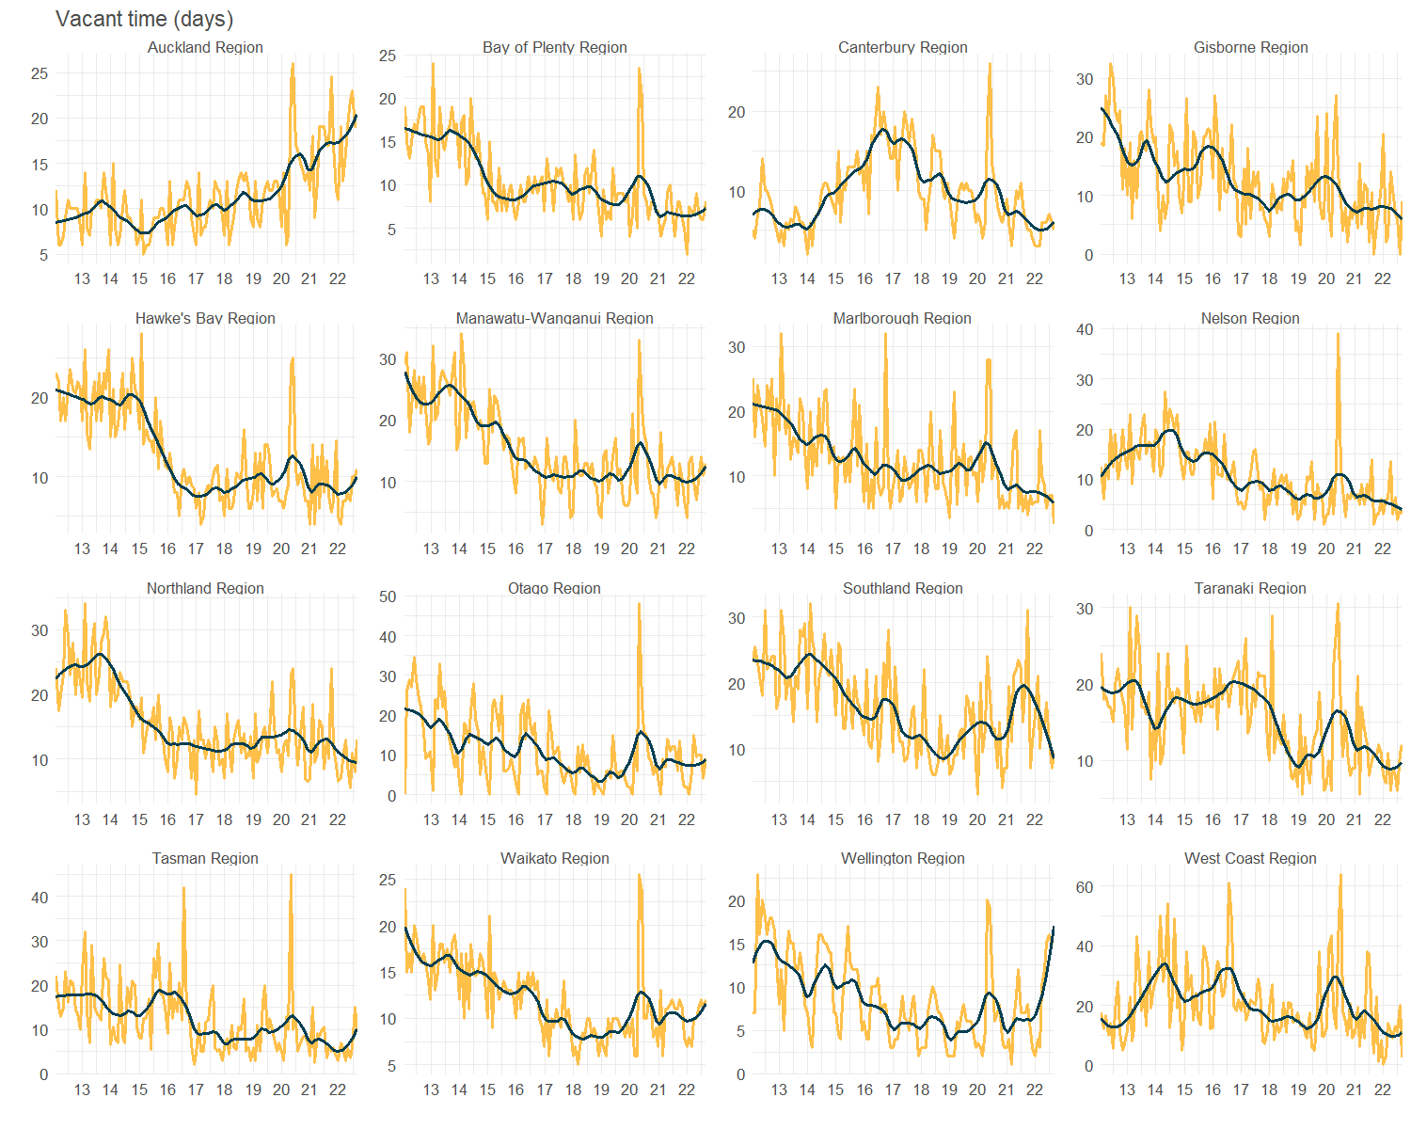
Alternative measure of relative supply and demand: Vacant time
Notes:
Interpretation in the next slide

Slide 11
Alternative measure of relative supply and demand: Vacant time
Notes:
Interpretation in the next slide

Slide 12
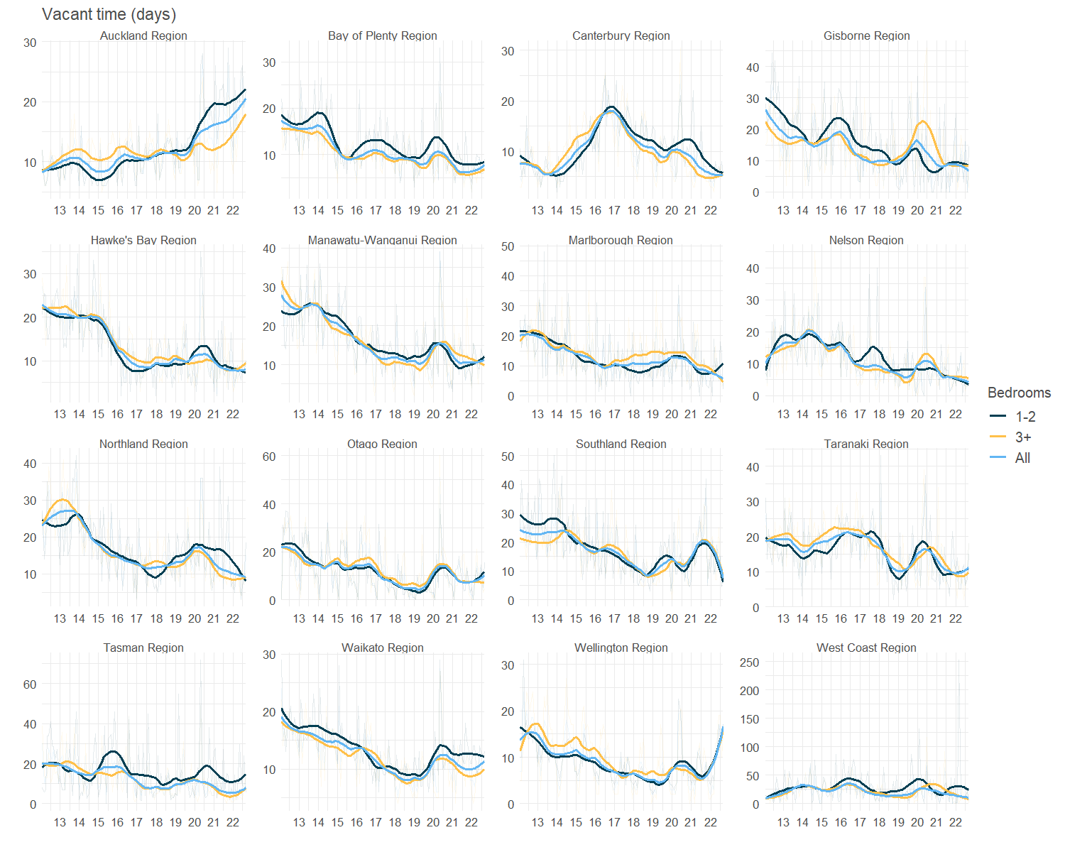
Alternative measure of relative supply and demand: Vacant time
Notes:
Interpretation in the next slide

Slide 13
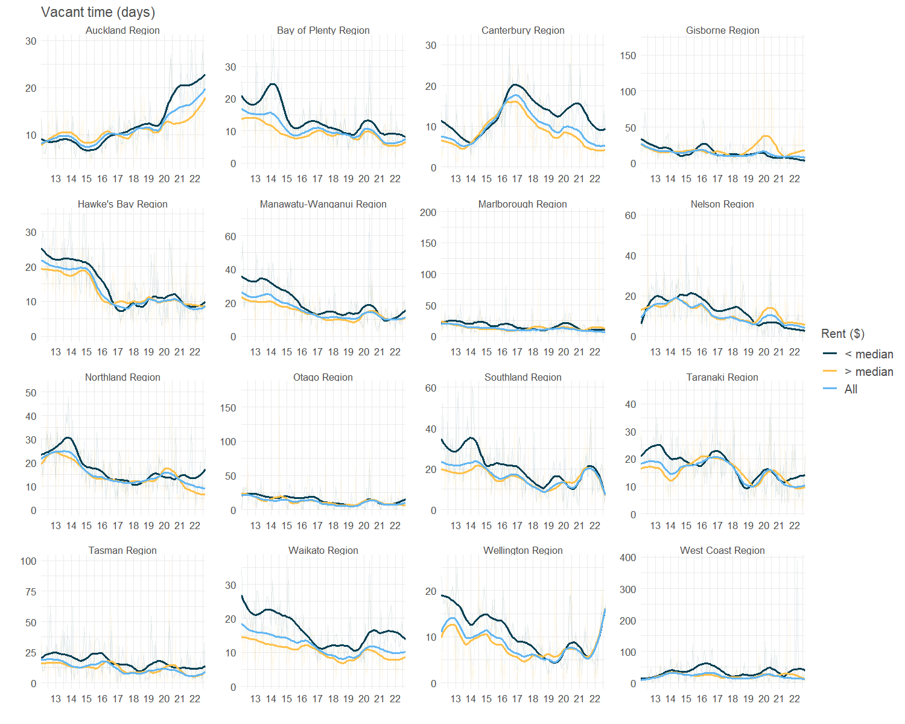
Alternative measure of relative supply and demand: Vacant time
Notes:
Interpretation in the next slide

Slide 14
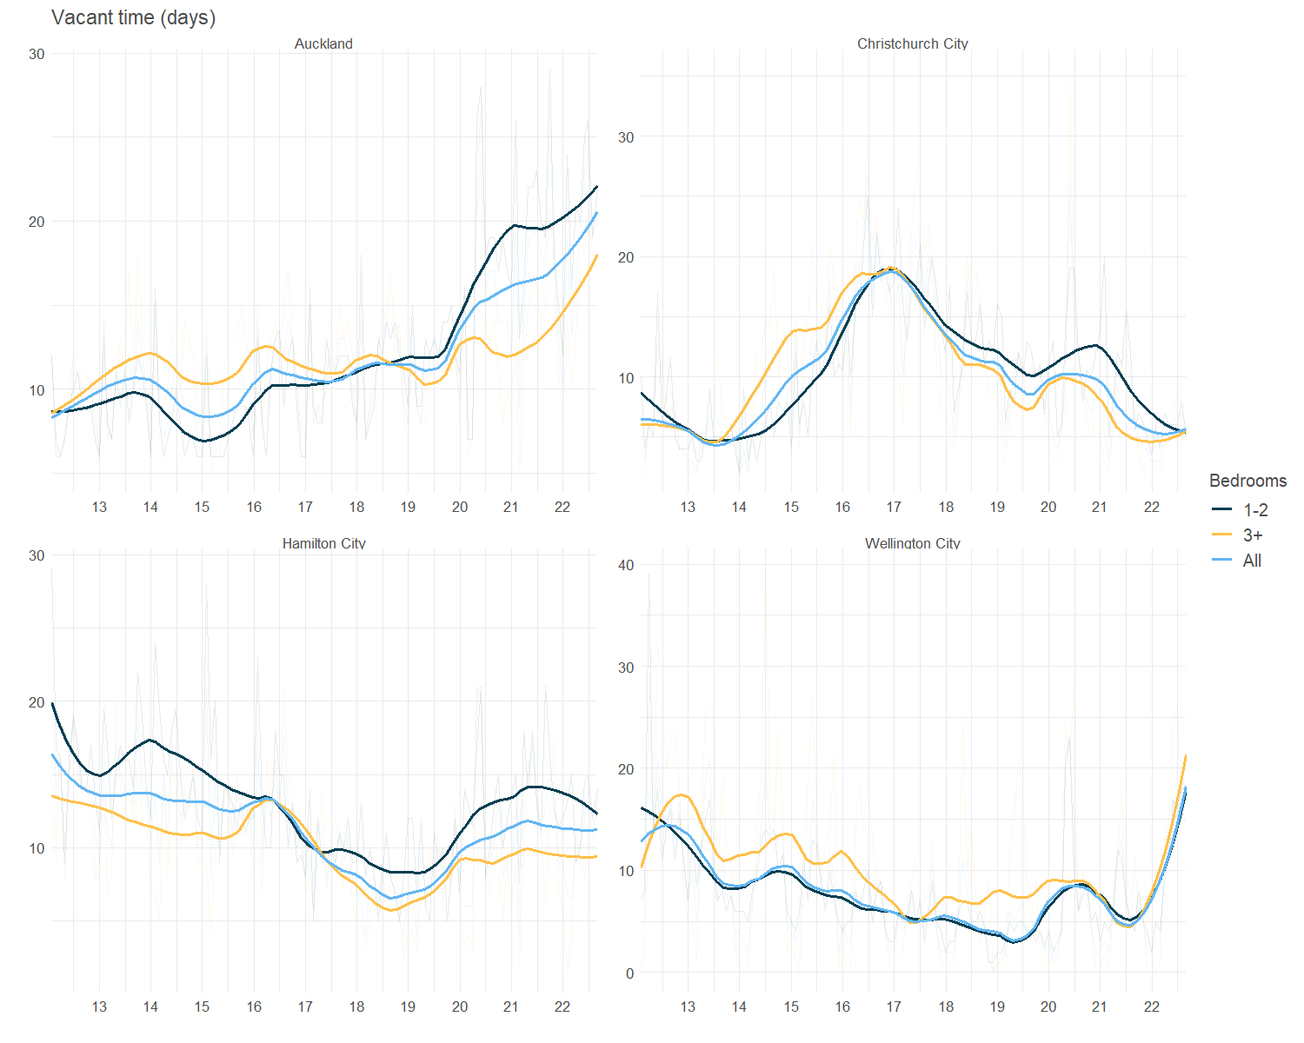
Alternative measure of relative supply and demand: Vacant time
Notes:
Interpretation in the next slide

Slide 15
Alternative measure of relative supply and demand
 | Quarterly rent inflation | Quarterly rent inflation
Predictors | Estimates | Estimates
Wage growth (deviation from sample mean 0.93, lagged) | 0.45 *** (0.13) | 0.41 *** (0.14)
People per dwelling (deviation from sample mean 2.57, lagged) | 7.63 *** (2.71)
Change in vacant time |  | -0.20 ** (0.08)
Observations | 56 | 56
R² / R² adjusted | 0.606 / 0.508 | 0.599 / 0.499
* p<0.1 ** p<0.05 *** p<0.01
Notes:
Interpretation in the next slide

Slide 16
Interpreting key coefficients
Variables | Change | Effect
Wage | 1 percentage points increase in growth of average weekly earnings | 0.25 percentage points increase in rent inflation
Relative demand and supply | 200,000 additional people or 74,000 less dwellings from Q1-2022 level | 0.5 percentage points increase in rent inflation
Home loan credit conditions | 10 percent increase in floating mortgage rate from same time last year | 0.3 percentage points increase in rent inflation
General inflation | 1 percent increase in inflation excluding rents | 0.01 percent increase in rent inflation

Slide 17
The bigger the supply and demand gap, the stronger the correlation between wage and rent
 | Quarterly rent inflation | Quarterly rent inflation
Predictors | Estimates | Estimates
Wage growth (deviation from sample mean 0.93, lagged) | 0.463 *** (0.138) | 0.564 (0.631)
People per dwelling (deviation from sample mean 2.57, lagged) | 7.482 *** (2.758)
Wage growth x People per dwelling | 1.121 (2.613)
Vacant time (lagged) |  | -0.198 ** (0.078)
Wage growth x Vacant time |  | -0.014 (0.055)
Observations | 56 | 56
R² / R² adjusted | 0.608 / 0.499 | 0.600 / 0.488
* p<0.1 ** p<0.05 *** p<0.01
Notes:
Higher people per dwelling (more demand relative to supply) => stronger relationship between wage and rents
Higher vacancy rate (more supply relative to demand) => weaker relationship between wage and rents
Higher vacant time (properties take longer to fill => more supply relative to demand) => weaker relationship between wage and rents

Slide 18
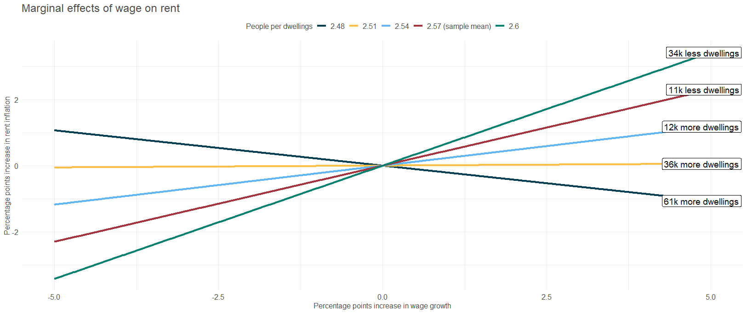
The bigger the supply and demand gap, the stronger the correlation between wage and rent

Slide 19
Key takeaways
Wage, relative supply and demand, and credit conditions are the main drivers of rent
Overall, the explanatory variables can explain around 50-60% of the variation
Rent and wage tend to track each other over time. However, the bigger the supply and demand gap, the stronger the impact of wage on rent

Slide 20
Next steps
Panel regression at regional level
Look at how the key coefficients vary at regional level

Slide 21
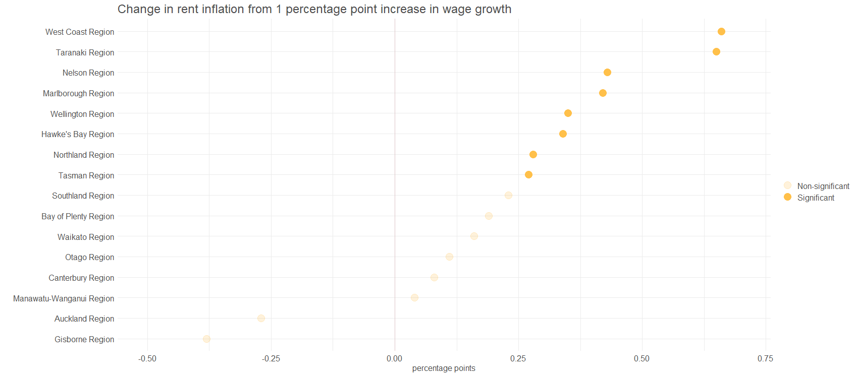

Slide 22
